Slide 1



MARATHON ASSET MANAGEMENT
CORNELL CFEM CAPSTONE 2026
Reproducing and Extending the BDC Private Credit Index
An end-to-end walkthrough of the pipeline: how it runs, what goes in, what comes out, the parameter choices that drive the results
SPONSOR: Jason Foster
ADVISOR: Sasha Stoikov
TEAM: Alex Lee, Max Yap, Minxi Lin, Yung Lee, Olivia Mei
DATE: September 3, 2026
1

Slide 2
MARATHON ASSET MANAGEMENT
CORNELL CFEM CAPSTONE 2026
Overview
1 - Scope of the Work
2 - Pipeline Structure
3 - Inputs
4 - Outputs
5 - Reproduction vs. Report
6 - Parameter Choices
7 – Major Defect Found & Fixed
8 - Conclusion & Discussion
2

Slide 3
MARATHON ASSET MANAGEMENT
CORNELL CFEM CAPSTONE 2026
1. Scope of the Work
Three Goals
Rerun the pipeline end-to-end – every stage executed, not merely inspected
Extend out the report’s 2023Q1 - 2025Q2 window to 2023Q1 - 2026Q2
Validate that the reproduced results still match the December 2025 findings
What Changed Operationally
Reference data (FX, SOFR, EFFR, CDLI) refreshed to 2026Q2
Sector classification migrated from OpenAI to Claude
Headline Results
Reproduced the report’s figures closely on the identical window (2023Q1 - 2025Q2)
After one data-quality fix, constructed CDLI index vs. CDLI improved substantially: correlation: 96.2%, tracking error: 0.36%
Constructed CDLI-S index vs. CDLI-S: correlation: 96.5%, tracking error: 0.31%
3

Slide 4
MARATHON ASSET MANAGEMENT
CORNELL CFEM CAPSTONE 2026
2. Pipeline Structure
Data Ingestion (stages 1-2)
run_bdc_universe.py – scrapes EDGAR for N-54A/N-54C filings to identify every BDC and its active window
run_downloader.py – pulls all 10-K/10-Q filings into a per-CIK local cache, rate-limited
Extraction & Cleaning (stages 3-5)
run_ixbrl_parser.py – extracts SOI facts from iXBRL instance documents
run_preprocessor.py – consolidates per-file output into one panel with quarter labels
run_ixbrl_pipeline.py – rate/spread normalization, FX conversion, scale correction, SOFR-based coupon estimation
Classification & Construction (stages 6-7)
get_seniority_debttype.py – rules-based seniority, then rules-plus-LLM sector classification, checkpointed
index_construction.py – flow returns, MV weighting, index levels, and benchmark comparisons
4

Slide 5
MARATHON ASSET MANAGEMENT
CORNELL CFEM CAPSTONE 2026
3. Inputs
File | Contents | Now Through
FX.csv | Treasury quarterly exchange rates | 2026Q2
SOFR.csv | Quarterly avg SOFR (ECB series) | 2026Q2
Search.xlsx | Daily EFFR + SOFR (NY Fed) | 2026-08-28
cdli.csv | Cliffwater Direct Lending Index | 2026Q2
cdli-s.csv | CDLI-Senior sub-index | 2026Q2
Primary Inputs: ~ 33.0 GB of raw 10-K/10-Q filings cached per CIK, plus the parsed loan-level panel
Coverage starts at 2023Q1, when iXBRL adoption crosses ~ 90% of filings
Figure 1. Referenced data files refreshed this cycle
Parsed panel: 573K rows | Window: 2023Q1 - 2026Q2
5

Slide 6
MARATHON ASSET MANAGEMENT
CORNELL CFEM CAPSTONE 2026
4. Outputs
Measure | Value | Note
Annualized return | 10.84% | Geometric, over 3.25 years of quarterly returns
Annualized volatility | 1.54% | Characteristically low — income-dominated returns
Correlation to CDLI | 96.17% | 2023Q2–2026Q2 (2023Q1 return undefined for the given window)
Tracking error | 0.36% | Annualized
Index level | 143.4 | From base 100 at 2023Q1
Cleaned panel carries normalized rates, USD-converted amounts, and audit columns (change_tracker, check_1-3, scale flags)
Enriched panel adds sector and instrument seniority; a cached LLM checkpoint makes reruns free
Six charts, correlation/tracking-error stats, and senior-loan & sector subindices wrap up the analysis
Figure 2. Headline index results, 2023Q1 - 2026Q2
Sector coverage ~80% | Seniority coverage ~63% | Full LLM rerun cost: ~$10
6

Slide 7
MARATHON ASSET MANAGEMENT
CORNELL CFEM CAPSTONE 2026
5. Reproduction vs. Report (CDLI)
Metric | Report (Dec '25) | Reproduced | Verdict
Quarterly returns 23Q2–25Q2 | 2.91…2.62% | 2.92…2.62% | Match
Correlation to CDLI | 86.95% | 85.78% | Match
Tracking error | 0.33% | 0.35% | Match
Annualized return | 11.23% | 11.61% | Match
Senior sub-index — corr. | 87.5% | 87.22% | Match
Senior sub-index — TE | 0.32% | 0.33% | Match
Seniority coverage | 64.07% | 63.37% | Match
2023Q1 return | 1.90% | - | Diverges
Restricted to the report’s exact window, the pipeline reproduces the published figures closely
One divergence: 2023Q1 is the first quarter, so a flow-based return is undefined (2022Q4 data needed for computing 2023Q1 return)
Figure 3. Reproduction vs. Dec 2025 report, identical window
7 of 8 metrics match | 1 explained divergence (undefined 2023 Q1 return)
7

Slide 8
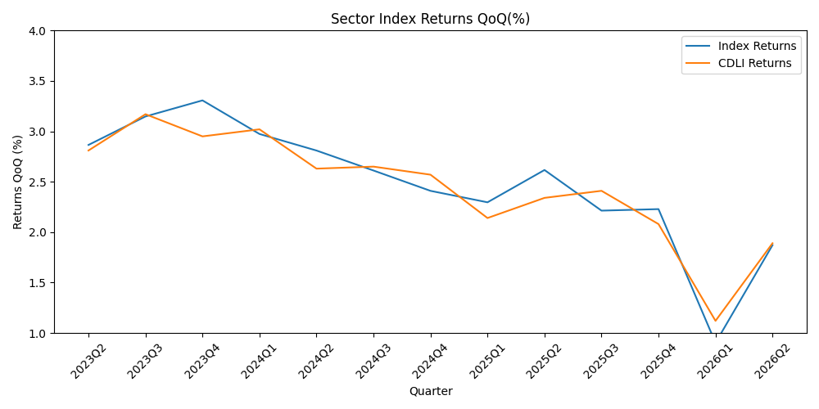
MARATHON ASSET MANAGEMENT
CORNELL CFEM CAPSTONE 2026
Constructed Index vs. CDLI Plot
8

Slide 9
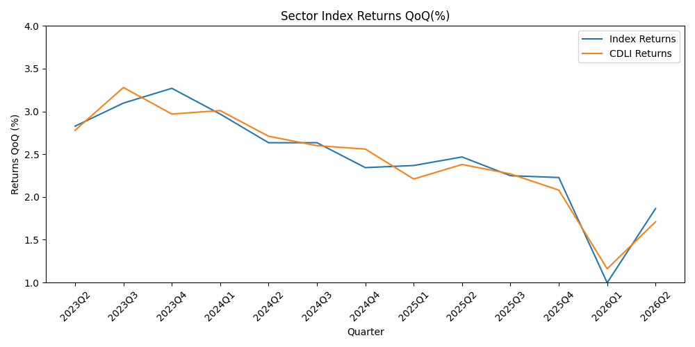
MARATHON ASSET MANAGEMENT
CORNELL CFEM CAPSTONE 2026
Constructed Index vs. CDLI-S Plot
9

Slide 10
MARATHON ASSET MANAGEMENT
CORNELL CFEM CAPSTONE 2026
6. Parameter Choices
Sector Classification
conf_thresh = 0.70: at 0.90, Haiku’s confidence is at most 0.85 and zero names cleared the bar
llm_model = claude-haiku-4-5: ~$10 for the full 100k-name runs
checkpoint_path added to store previous results for later use
Data Cleaning
SPREAD_RANGE 0-20% and RATE_RANGE 0-50%: plausible ranges for a spread, floor, or coupon
VALUE_RATIO_RANGE 0-3x (new): fair value beyond 3 x principal is treated as a unit-scale error
Index Construction
num_years_now = len(returns)/4 (fixed): generalized based on data, rather than hardcoded
start_idx = 1: drops the structurally invalid first quarter
10

Slide 11
MARATHON ASSET MANAGEMENT
CORNELL CFEM CAPSTONE 2026
7. Major Defect Found & Fixed
Fair values inflated 1000x by unit-tagging errors
Some filings tagged fair value and cost in a different unit scale from principal
Brivo, Inc.: $40.19 billion (2025Q2) → $41.00 million (2025Q3)
Dejero Labs Inc.: $14.71 billion (2025Q2) → $14.97 million (2025Q3)
Linxup, LLC: $30.50 billion (2025Q2) → $30.66 million (2025Q3)
Implemented normalize_value_scale() to anchor FV and cost against the position’s own principal; corrected 1,459 FV and 1,127 cost rows
Impact: correlation to CDLI drastically increased from 68.0% to 96.2%; tracking error notably decreased from 0.81% to 0.36%
11

Slide 12
MARATHON ASSET MANAGEMENT
CORNELL CFEM CAPSTONE 2026
8. Conclusion & Discussion
Reproduction validated
Reproduces the report’s figures closely in the identical window (2023Q1 - 2025Q2)
Corr. 96.2%, tracking error 0.36% vs. CDLI over the full 2023Q1 - 2026Q2 window
Found and Resolved a Major Defect
Fixing the FV and cost scaling errors drove the biggest boost in tracking accuracy and correlation
Potential Future Extensions
Constructing Subindices for additional dimensions
Using an HTML parser for greater data coverage
Implementing nowcasting to increase frequency
Detecting warning signals for drawdown (e.g., % PIK increase, valuation dispersion, BDC exposure)
12

